Slide 1
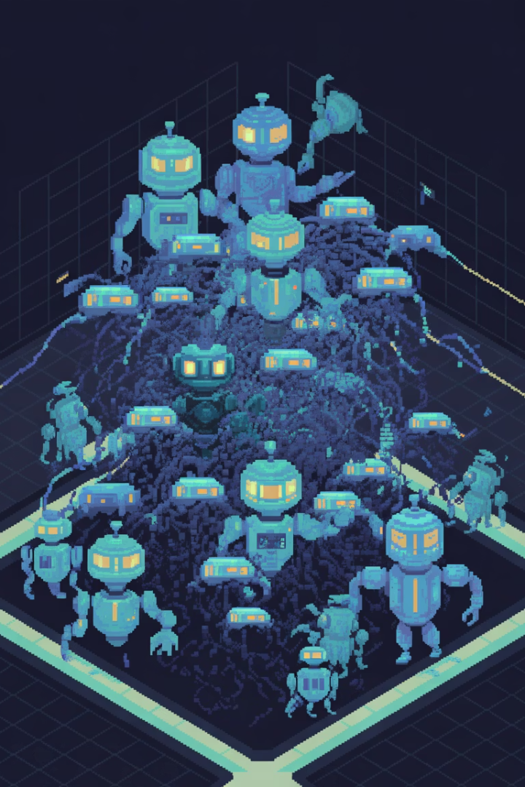

AI Agents Bootcamp 2025
23–27 June 2025 • UTM — Chișinău
by Braga Basil
Notes:
• Welcome to the AI Agents Bootcamp 2025, taking place from June 23-27 in Chișinău, Moldova at the University of Moldova. • Over the course of 5 days, attendees will have the opportunity to learn from industry experts, participate in hands-on workshops, and explore the cutting edge of AI technology. • The goal is to equip participants with the skills and knowledge needed to develop the next generation of intelligent systems that will shape our future. • I'm excited to dive into the program and see what innovative solutions emerge from this gathering of AI pioneers.

Slide 2




Welcome to AI Agents Bootcamp!
Organized by UTM
Trainer: Vasili Braga
SmartAgents SRL
Hosted at the Technical University of Moldova
Expert instructor leading the bootcamp
HPC & LLM Systems
Notes:
Welcome everyone to the AI Agents Bootcamp! I'm excited to have you all here today. This bootcamp is organized by the Technical University of Moldova, so we're grateful to be hosted on their campus. Your instructor for this bootcamp is Vasili Braga, an expert in AI systems and machine learning. He'll be leading us through the next few days. The bootcamp is being put on by SmartAgents SRL, a company that specializes in high-performance computing and large language models. Let's dive in and get started! I'm looking forward to an engaging and informative few days ahead.

Slide 3
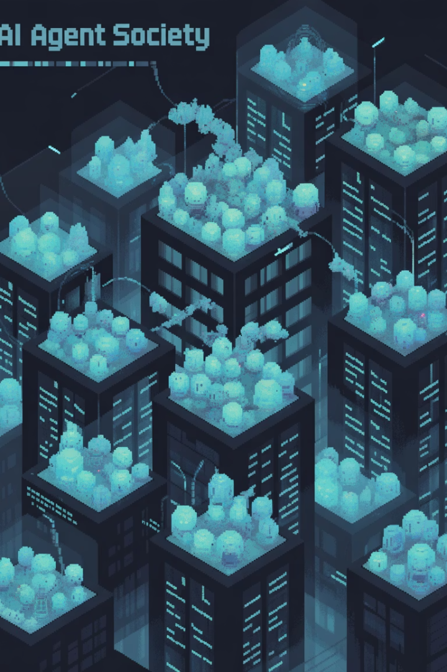





Goals of the Bootcamp
Build your own AI Agent Society
Understand MAS, LLMs, SLMs, and RAG
Create a functioning ecosystem of intelligent agents
Master the theoretical foundations of multi-agent systems
Create working multi-agent systems
Leave with a fully functional MAS MVP
With agents that learn and collaborate
You can demo and reuse
Explore the ethics and safety of agent-based AI
Understand the responsible use of AI agents
Notes:
The goal of this bootcamp is to help you build your own AI agent society - a functioning ecosystem of intelligent agents that can learn and collaborate. You'll gain a deep understanding of the theoretical foundations of multi-agent systems, including topics like LLMs, SLMs, and RAG. By the end, you'll have created a working multi-agent system that you can demo and reuse. We'll also explore the important ethical and safety considerations around the responsible use of AI agents. This is an exciting opportunity to become an expert in this cutting-edge field and develop a powerful AI tool you can apply to real-world problems.

Slide 4
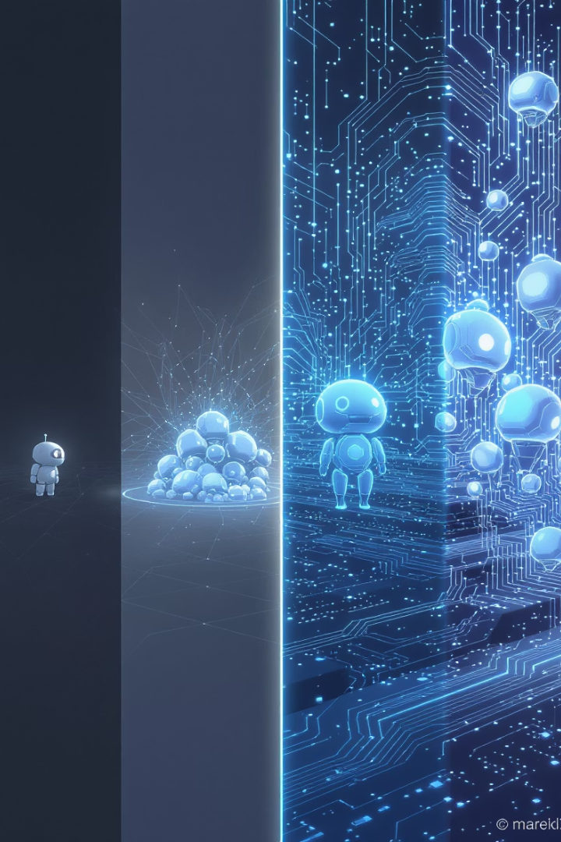




Agenda Overview
Day 1
Teach a single agent to think and remember
Day 2
Make agents talk, bid, and negotiate
Day 3
Build teams of agents that solve tasks
Day 4
Package and present your own intelligent agent society
Notes:
This slide provides an overview of the 4-day agenda for the presentation. On Day 1, we'll focus on teaching a single agent to think and remember. On Day 2, we'll make agents talk, bid, and negotiate with each other. Day 3 will be about building teams of agents that can solve tasks together. Finally, on Day 4, we'll package and present our own intelligent agent society. The visual on the slide gives a nice progression from simple to more complex AI agent systems. This high-level agenda will help the audience understand the flow and focus of the 4-day presentation.

Slide 5

Day 1 Schedule
10:00
1
Welcome & Introduction
2
10:30
Why Agents, MAS, and RAG?
11:15
3
Coffee Break
4
11:30
Installing and Using Agent Frameworks
12:30
5
Running SLMs Locally
6
13:15
Lunch Break
14:15
7
Building Your First Agent
8
15:30
Coffee Break
15:45
9
Handling LLM Pitfalls
10
16:30
Reflection & Wrap-Up
Notes:
Welcome everyone to Day 1 of our training on agents, multi-agent systems, and reinforcement learning. In the next 30 minutes, we'll discuss why these topics are important and the key concepts we'll be covering. This will set the stage for the rest of the day's activities. I encourage you to ask questions throughout the session - your participation will help ensure we cover the material effectively. Let's dive in!

Slide 6
Housekeeping
📶 WiFi
🔗 Bootcamp repo
[network name + password]
[GitHub/Colab link]
🤝 Collaboration encouraged!
🙋 Questions
Work together to solve challenges
Ask anytime — interactive format
👩‍💻 Let's start now
📋 Feedback
Open the repo and run your first cell!
End of day
💻 Bring your notebook
You'll need your own laptop for all activities
Notes:
• Welcome everyone to our bootcamp session today! I'm excited to get started and help you all learn some new skills. • First, let's cover a few housekeeping items. • We have WiFi available - the network name and password are [network name + password]. • You can find the bootcamp repository at [GitHub/Colab link]. Make sure to open that up and run your first cell to get started. • Throughout the session, I encourage you all to collaborate and work together to solve the challenges. Don't hesitate to ask questions - this is an interactive format and I'm here to help. • At the end of the day, please provide some feedback so we can continue improving the bootcamp. • And lastly, remember to bring your own laptop - you'll need it for all the activities we have planned. • Alright, let's dive in! Open up that repo and let's get coding.

Slide 7
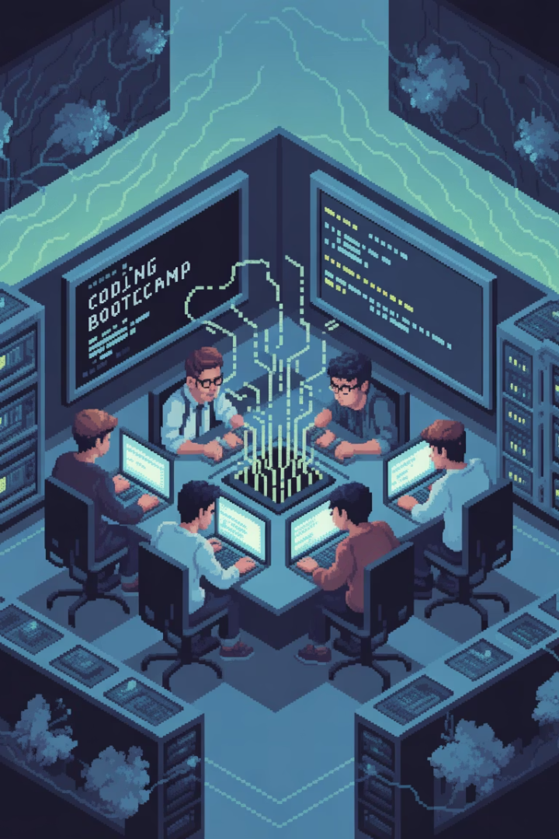
Participant Expectations
You will:
Be ready to:
Build agents yourself
Day 1: Work in Google Colab / Kaggle — no local install required
Try out code live
Work with small teams
Share findings and questions
Engage in discussion and collaborative learning
Provide feedback
Experiment — don't be afraid to break things!
Notes:
Participants will be building their own agents and trying out code live during the session They'll be working in small teams to share findings, ask questions, and provide feedback On the first day, they'll be using Google Colab or Kaggle, so no local installation is required We encourage participants to engage in discussion and collaborative learning throughout the session Experimentation is encouraged - don't be afraid to try new things and break the code!

